Slide 1



Ad Hoc Insights
Consumer Goods
Presented by U Roshan Kumar Patro

Slide 2
Atliq Hardwares (imaginary company) is one of the leading computer hardware producers in India and well expanded in other countries too.
However, the management noticed that they do not get enough insights to make quick and smart data-informed decisions.
They want to expand their data analytics team by adding several junior data analysts.
Tony Sharma, their data analytics director wanted to hire someone who is good at both tech and soft skills. Hence, he decided to conduct a SQL challenge which will help him understand both the skills.
Background / Context

Slide 3
AtliQ’s Products
N & S
Storage
Networking
Wi-Fi Extender
External SSD
USB Flash Drive
PC
Notebook
Desktop
Business Laptop
Personal Laptop
Gaming Laptop
Personal laptop
Business Laptop
P&A
Accessories
Peripheral
Graphics Card
Internal HDD
Battery
Keyboard
Mouse
Processors
Mother Board

Slide 4
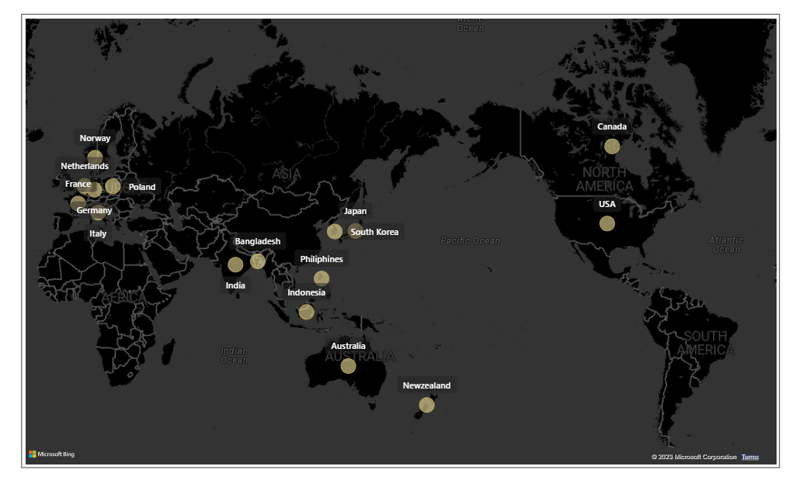
AtliQ’s Market

Slide 5
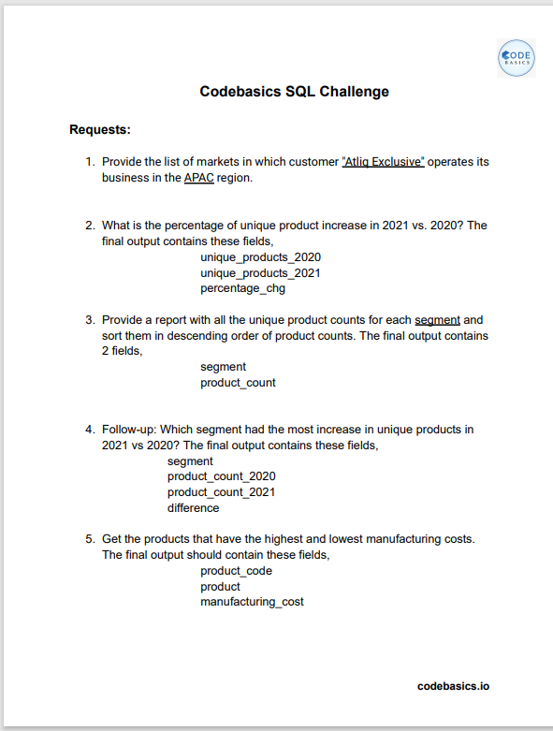
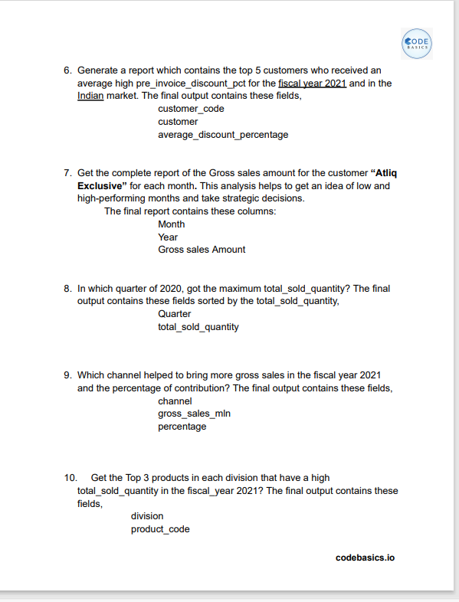


Ad Hoc Requests and Tools
Ad-Hoc-Requests
Tools

Slide 6
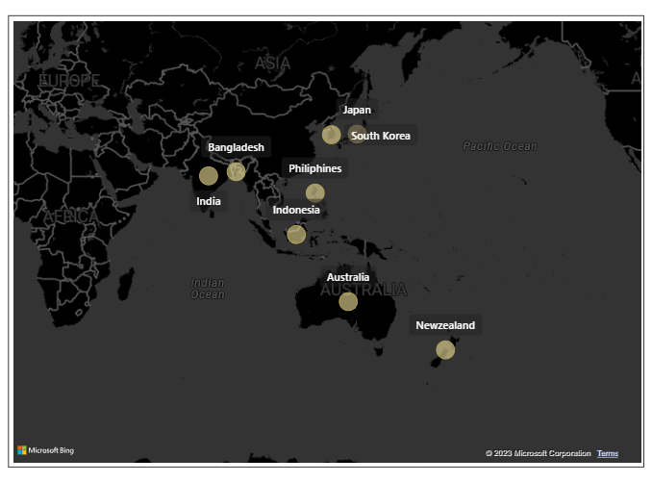
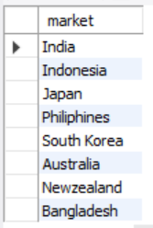
Request 1
Provide the list of markets in which customer "Atliq Exclusive" operates its business in the APAC region.
Insights - These are the countries AtliQ Exclusive is operating in the APAC Region.

Slide 7
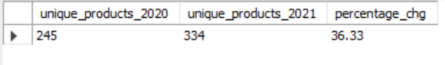
Request 2
Output
What is the percentage of unique product increase in 2021 vs. 2020? The
final output contains these fields,
unique_products_2020
unique_products_2021
percentage_chg

Slide 8
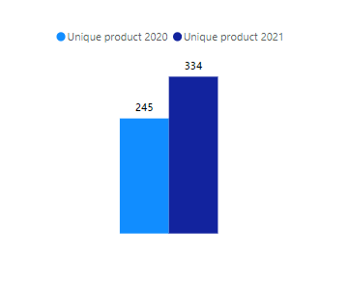
Insights
Unique Products FY 2020 vs FY 2021
AtliQ hardware has significantly increased number of unique products, with a 36.33% rise from 245 in 2020 to 334 in 2021. This suggests potential expansion and diversification in their product portfolio.
36.33%

Slide 9
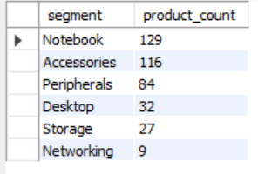
Request 3
Output
Provide a report with all unique product counts for each segments and sort them in descending order of product counts. The Final output should contains 2 fields,
segment
product_count

Slide 10
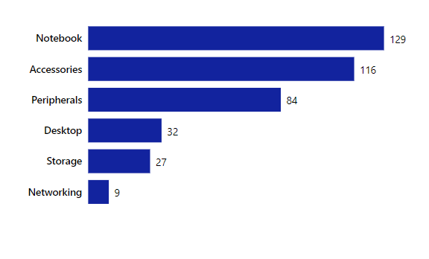
Insights
Unique Products count for each segment
Segments like notebook, accessories, and peripherals have the highest unique products while desktop, storage, and networking segments lag behind with fewer products.
Atliq hardware should diversify their products by increasing the product portfolio in low performing segmenst

Slide 11
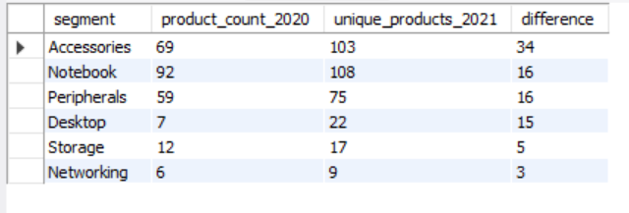
Request 4
Output
Follow up: Which segment had the most increase in unique products in 2020 vs 2021? The final output should contain these fields
segment
product_count_2020
product_count_2021
difference

Slide 12
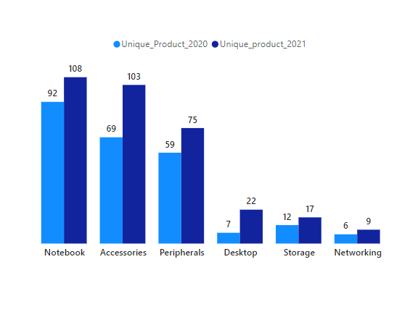
Insights
Unique Products FY 2020 vs 2021
Segments such as accessories, notebooks, and peripherals have experienced remarkable growth in the number of unique products between 2020 and 2021 while storage and networking segments had a muted growth presenting us a opportunity for focused growth strategies in these segments.

Slide 13
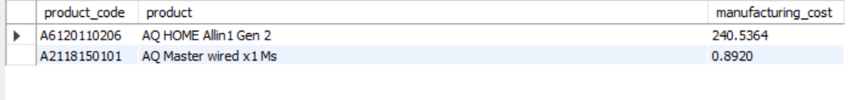
Request 5
Output
Get the products that have the highest and lowest manufacturing costs. The final output should contain these fields,
product_code
product
manufacturing_cost

Slide 14


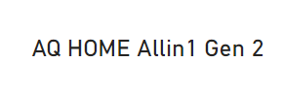
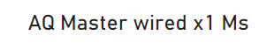
Insights
Product with Highest manufacturing cost
Product with lowest manufacturing cost
$ 240.54
$ 0.89
Personal Desktop
Mouse

Slide 15
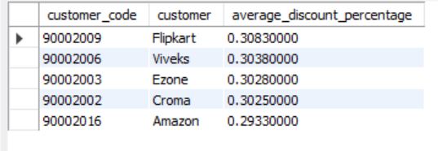
Request 6
Output
Generate a report that contains the top 5 customers who received an average high pre-invoice-discount-pct for the fiscal year 2021 and in the Indian market. The final output should contain these fields
customer_code
customer
average_discount_percentage

Slide 16
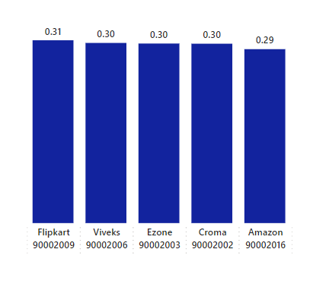
Insights
Top 5 Indian customers with highest avg discount percentage for FY 2021
Flipkart received the highest pre-invoice discount of 31% from Atiq Hardware in the fiscal year 2021 followed by Vivek's, Ezone, Croma and Amazon

Slide 17
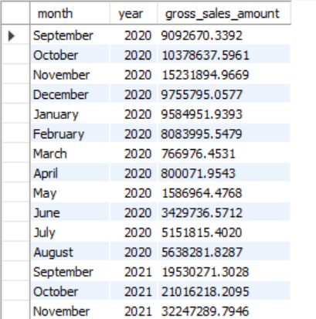
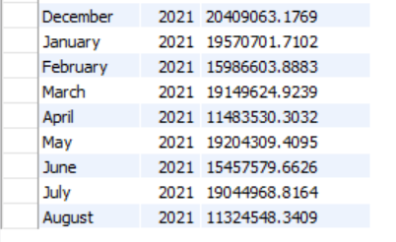
Output
Request 7
Get the complete report of the gross sales amount for the customer “Atliq Exclusive” for each month. This analysis helps to get an idea of low and high performing months and take strategic decisions. The final output should contains these columns
Month
Year
Gross sales Amount

Slide 18
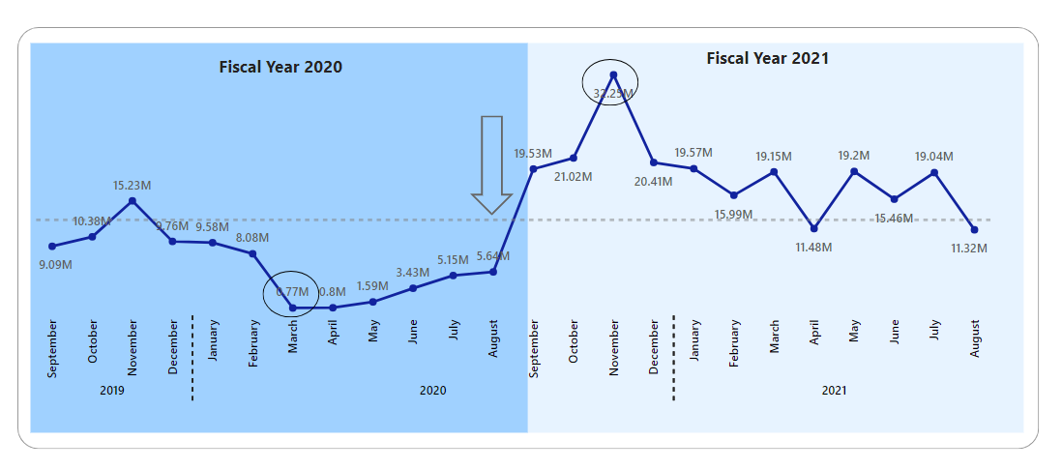
Insights
The Highest performing month for AtliQ Exclusive was November 2021 with Gross sales of 322.25M while the least performing month was March 2020 with Gross sales of 0.77 M .
The Sales Started to decline from march 2020 due to the Covid-19 Pandemic and lockdown by the fiscal year 2021 it has grown steadily compared to the fiscal year 2020 resulting in significant surge in sales of computer products due to online class and WFH setups post covid.

Slide 19
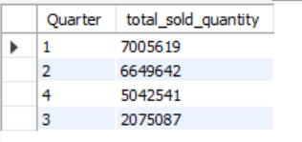
Request 8
Output
In which quarter of 2020, got the maximum total_sold_quantity ? The final output should contain these fields sorted by total_sold_quantity
Quarter
total_sold_quantity

Slide 20
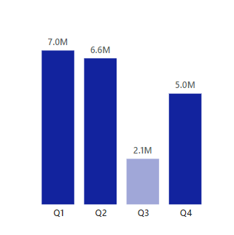
Insights
Quarterly sold quantity for FY 2020
The maximum amount of units sold were in Quarter 1 of FY 2020 while Quarter 3 had the least sales.
Sales in Q3 FY 2020 witnessed a decline due to the onset of the COVID-19 pandemic and subsequent lockdown measures but it began to rebound as the restrictions were relaxed indicating a positive trend towards recovery.

Slide 21
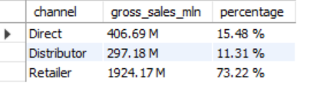
Request 9
Output
Which channel helped to bring more gross sales in the fiscal year 2021 and the percentage of contribution? The final output should contain these fields,
channel
gross_sales_mln
percentage

Slide 22
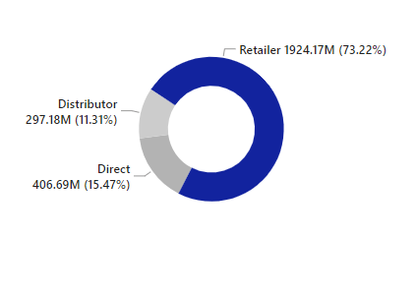
Insights
Channel wise Gross sales contribution for FY 2021
Retailer Channel has bought the maximum sales to the company with 73 % contribution.
Distributor Channel on the other hand, represents the smallest share at 11%, highlighting areas for potential growth.

Slide 23
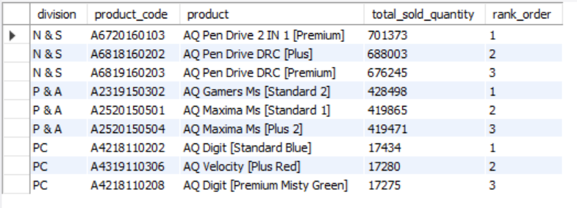
Request 10
Output
Get the top 3 products in each division that have a high total_sold_quantity in the fiscal year 2021? The final output should contain these fields,
division
product_code
product
total_sold_quantity
rank_order

Slide 24
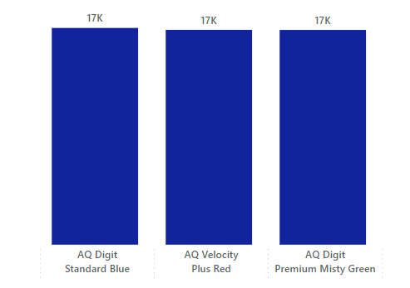
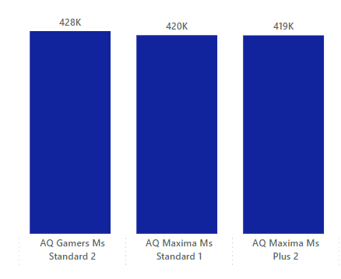
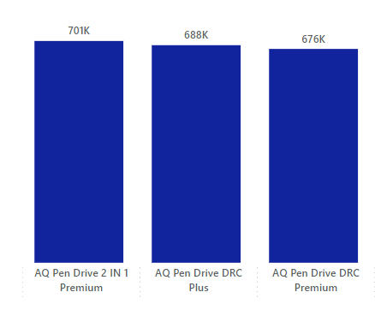


Insights
Top selling products for PC division
Top selling products for P & A division
Top selling products for P & A division
Top selling products for N & S division

Slide 25


THANK YOU !
Patro.roshan07@gmail.com
Roshan Patro

